Slide 1
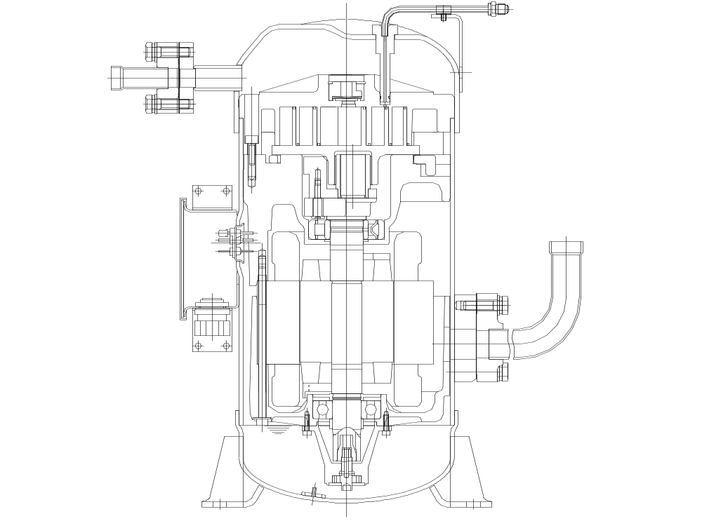
DAIKIN Scroll Compressors
Relief valve
Injection port for gas & liquid
Fixed Scroll
Orbiting Scroll
Anti-corrosive paint
(Epoxy zinc+Epoxy MIO)
Water-resist
terminal box
Ｔrochoid Pump
Anti-vibration &
Shock-resistant Mount

Slide 2
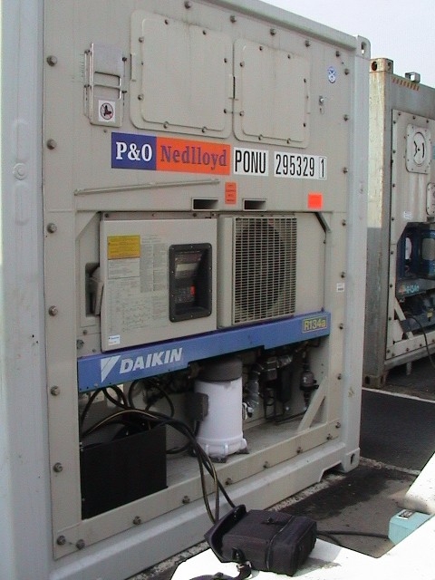
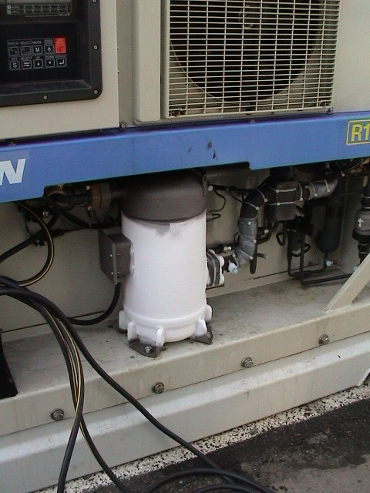
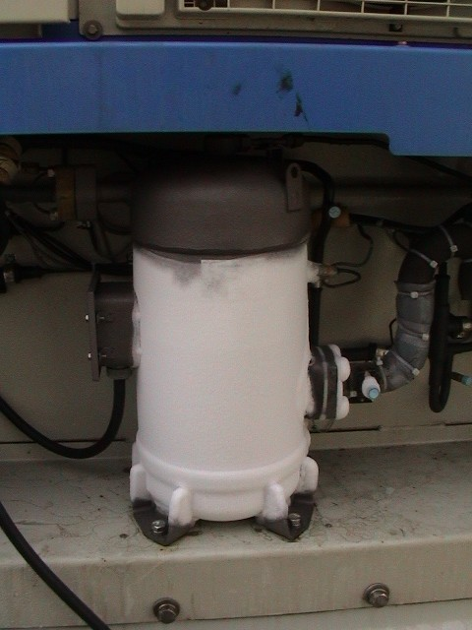
OVERCHARGED SYSTEM

